Slide 1
Optimal control
T. F. Edgar
Spring 2012

Slide 2
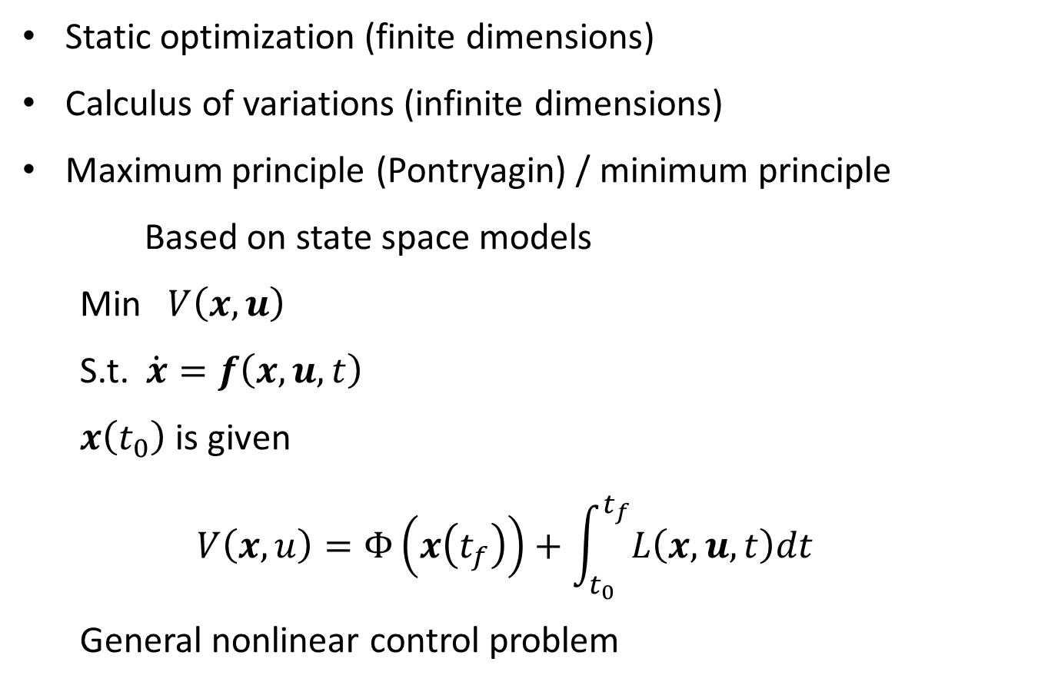
Optimal Control
Static optimization (finite dimensions)
Calculus of variations (infinite dimensions)
Maximum principle (Pontryagin) / minimum principle
Based on state space models
Min $V\left(x,u\right)$
S.t. $\dot{x}=f\left(x, u, t\right)$
$x\left(t_{0}\right)$ is given
$$V\left(x,u\right)=Φ\left(x\left(t_{f}\right)\right)+\int_{t_{0}}^{t_{f}}{L\left(x,u,t\right)dt}$$
General nonlinear control problem

Slide 3
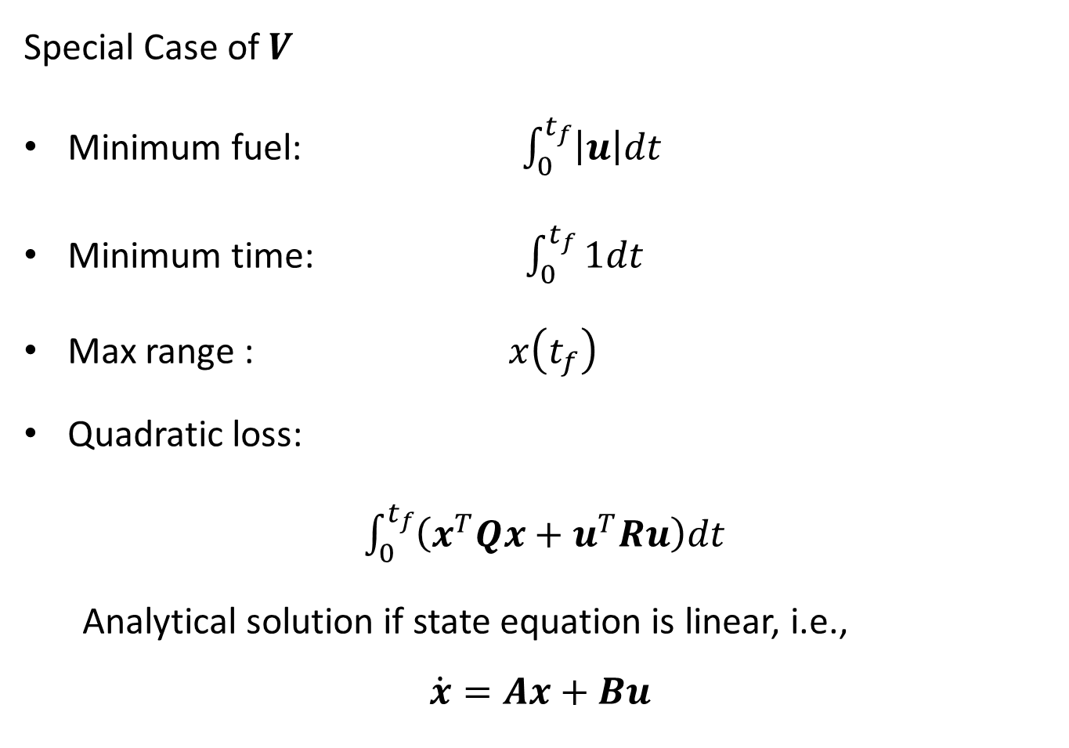
Special Case of $V$
Minimum fuel: $\int_{0}^{t_{f}}{\left|u\right|dt}$
Minimum time: $\int_{0}^{t_{f}}{1dt}$
Max range : $x\left(t_{f}\right)$
Quadratic loss:
$\int_{0}^{t_{f}}{\left(x^{T}Qx+u^{T}Ru\right)dt}$
Analytical solution if state equation is linear, i.e.,
$$\dot{x}=Ax+Bu$$

Slide 4
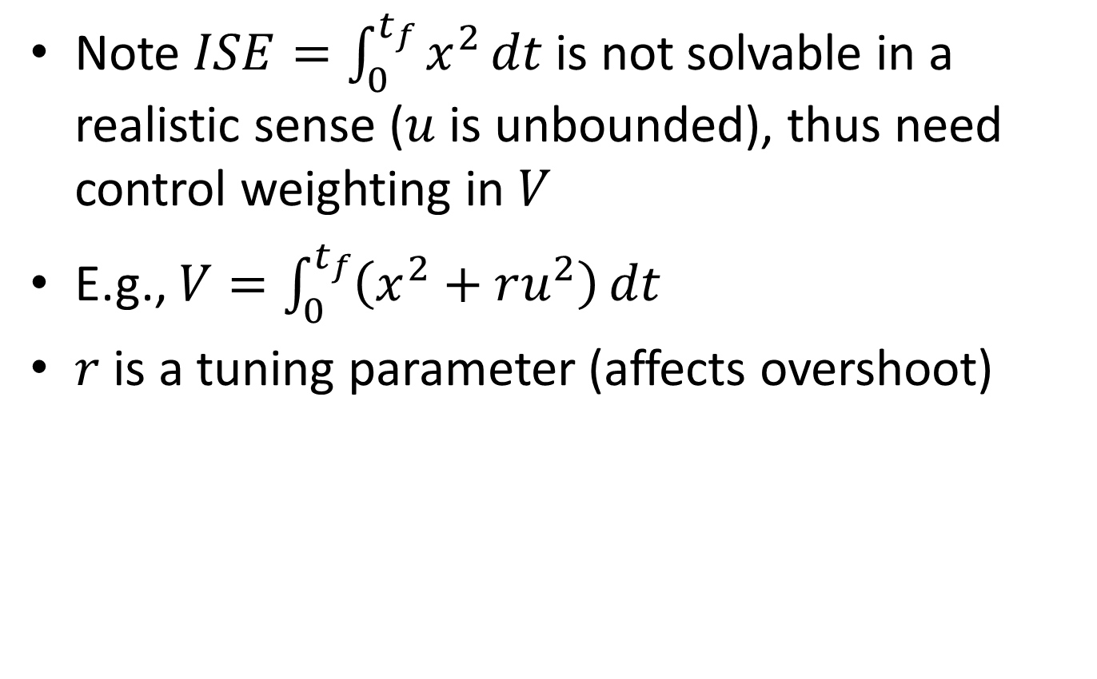
“Linear Quadratic” problem - LQP
Note $ISE=\int_{0}^{t_{f}}{x^{2}}dt$ is not solvable in a realistic sense ($u$ is unbounded), thus need control weighting in $V$
E.g., $V=\int_{0}^{t_{f}}{\left(x^{2}+ru^{2}\right)}dt$
$r$ is a tuning parameter (affects overshoot)

Slide 5
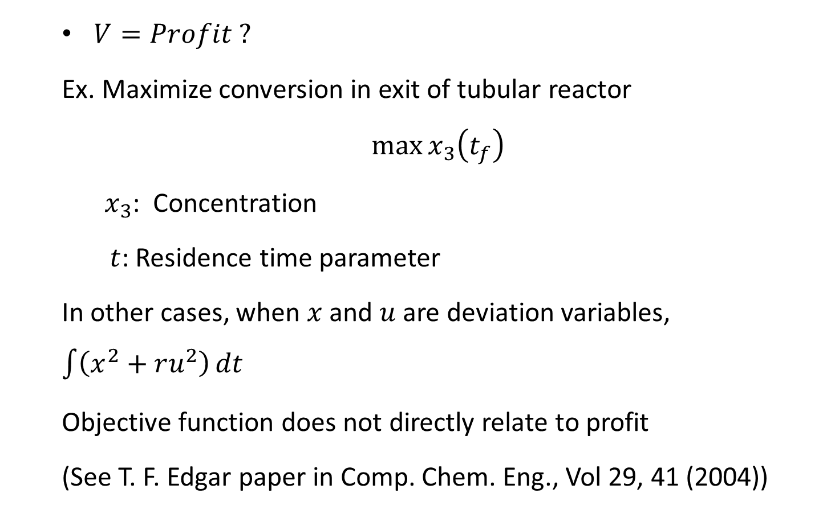
$V=Profit ?$
Ex. Maximize conversion in exit of tubular reactor
$$\max{x_{3}\left(t_{f}\right)}$$
$x_{3}$: Concentration
$t$: Residence time parameter
In other cases, when $x$ and $u$ are deviation variables, $\int{\left(x^{2}+ru^{2}\right)}dt$
Objective function does not directly relate to profit
(See T. F. Edgar paper in Comp. Chem. Eng., Vol 29, 41 (2004))

Slide 6
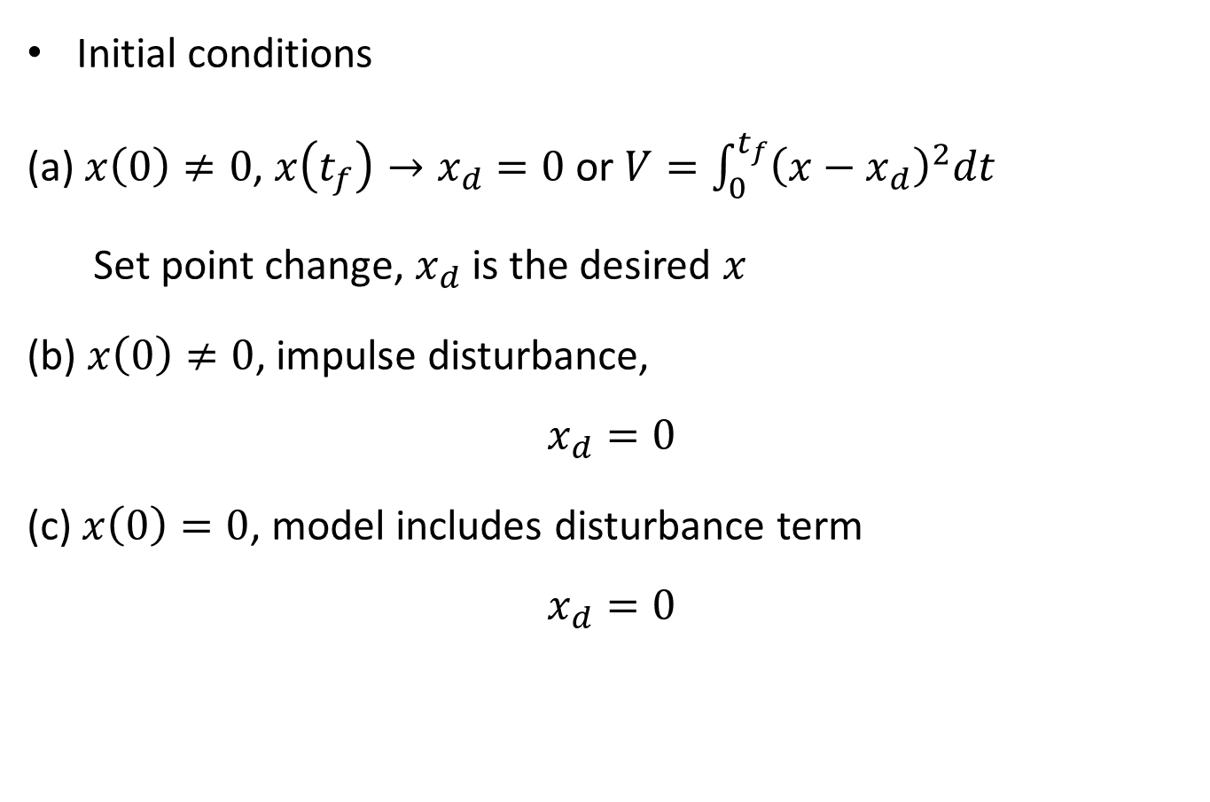
Initial conditions
(a) $x\left(0\right)≠0$, $x\left(t_{f}\right)→x_{d}=0$ or $V=\int_{0}^{t_{f}}{{\left(x−x_{d}\right)}^{2}dt}$
Set point change, $x_{d}$ is the desired $x$
(b) $x\left(0\right)≠0$, impulse disturbance,
$$x_{d}=0$$
(c) $x\left(0\right)=0$, model includes disturbance term
$$x_{d}=0$$

Slide 7
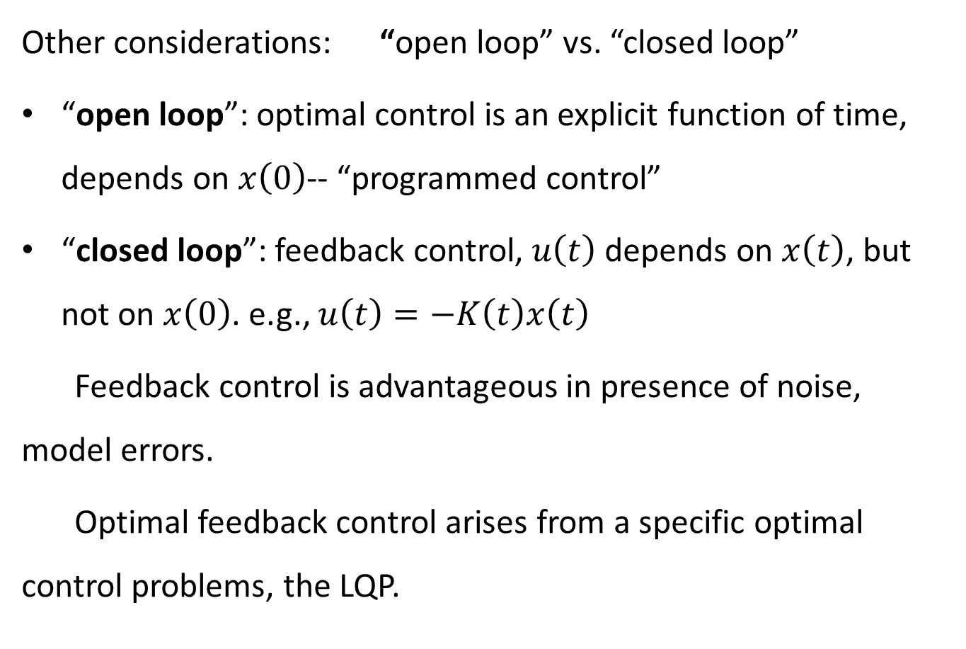
Other considerations: “open loop” vs. “closed loop”
“open loop”: optimal control is an explicit function of time, depends on $x\left(0\right)$-- “programmed control”
“closed loop”: feedback control, $u\left(t\right)$ depends on $x\left(t\right)$, but not on $x\left(0\right)$. e.g., $u\left(t\right)=−K\left(t\right)x\left(t\right)$
Feedback control is advantageous in presence of noise, model errors.
Optimal feedback control arises from a specific optimal control problems, the LQP.

Slide 8
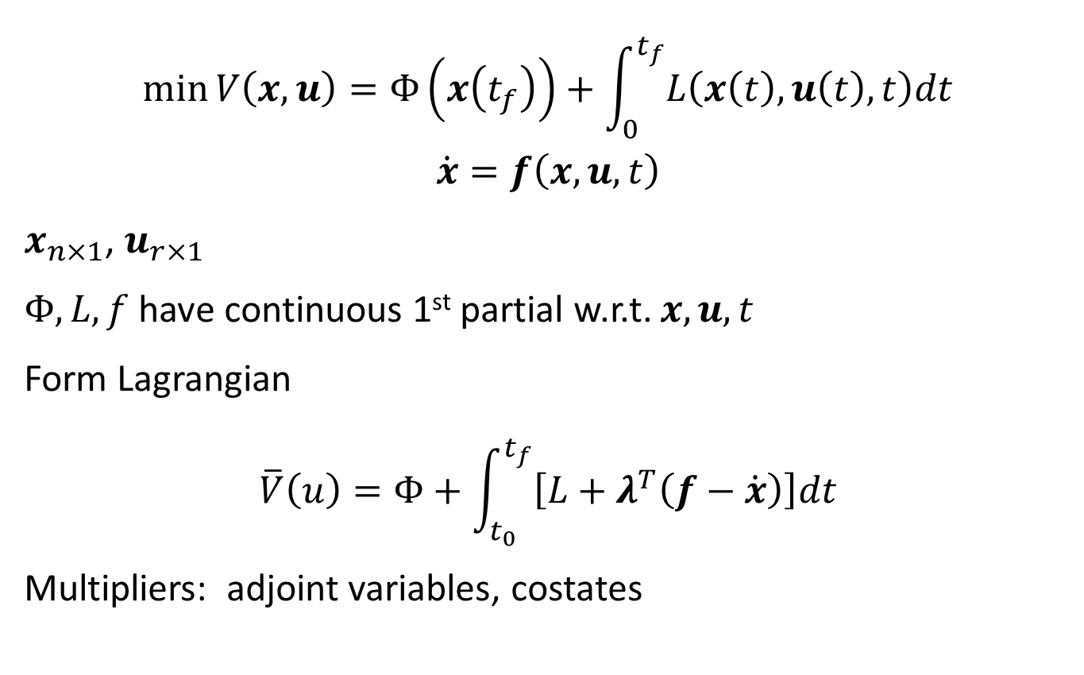
Derivation of Minimum Principle
$$\min{V\left(x,u\right)=Φ\left(x\left(t_{f}\right)\right)}+\int_{0}^{t_{f}}{L\left(x\left(t\right),u\left(t\right),t\right)dt}$$
$$\dot{x}=f\left(x,u,t\right)$$
$x_{n×1}$, $u_{r×1}$
$Φ, L, f$ have continuous 1st partial w.r.t. $x,u,t$
Form Lagrangian
$$\overline{V}\left(u\right)=Φ+\int_{t_{0}}^{t_{f}}{\left[L+λ^{T}\left(f−\dot{x}\right)\right]dt}$$
Multipliers: adjoint variables, costates

Slide 9
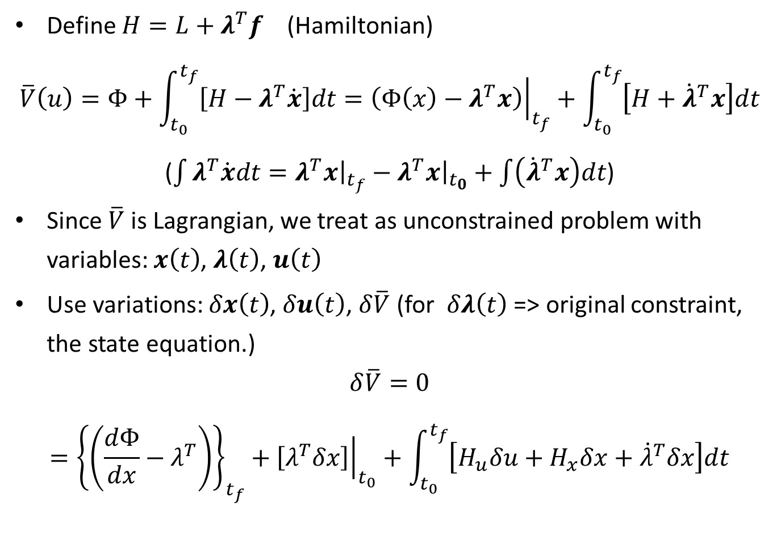
Define $H=L+λ^{T}f$ (Hamiltonian)
$$\overline{V}\left(u\right)=Φ+\int_{t_{0}}^{t_{f}}{\left[H−λ^{T}\dot{x}\right]dt}={\left.\left(Φ\left(x\right)−λ^{T}x\right)\right|}_{t_{f}}+\int_{t_{0}}^{t_{f}}{\left[H+{\dot{λ}}^{T}x\right]dt}$$
($\int{λ^{T}\dot{x}dt}={\left.λ^{T}x\right|}_{t_{f}}−{\left.λ^{T}x\right|}_{t_{0}}+\int{\left({\dot{λ}}^{T}x\right)dt}$)
Since $\overline{V}$ is Lagrangian, we treat as unconstrained problem with variables: $x\left(t\right)$, $λ\left(t\right)$, $u\left(t\right)$
Use variations: $δx\left(t\right)$, $δu\left(t\right)$, $δ\overline{V}$ (for $δλ\left(t\right)$ => original constraint, the state equation.)
$$δ\overline{V}=0={\left\{\left(\frac{dΦ}{dx}−λ^{T}\right)\right\}}_{t_{f}}+{\left.\left[λ^{T}δx\right]\right|}_{t_{0}}+\int_{t_{0}}^{t_{f}}{\left[H_{u}δu+H_{x}δx+{\dot{λ}}^{T}δx\right]dt}$$

Slide 10
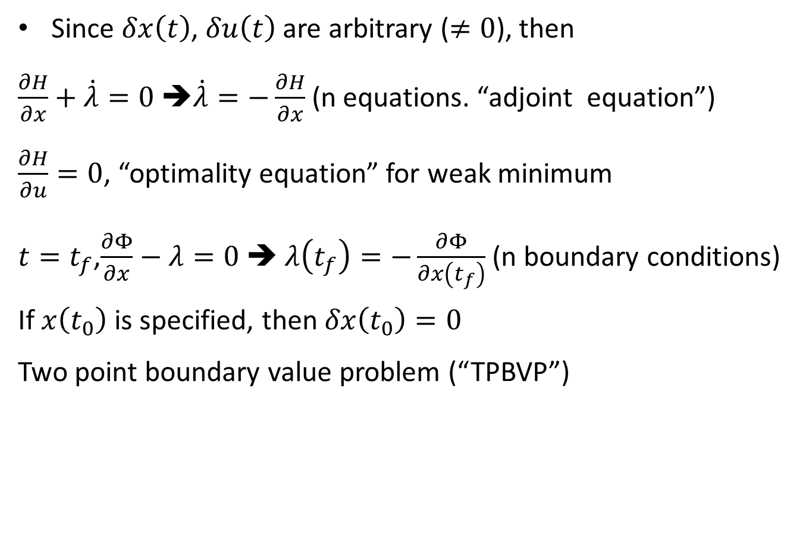
Since $δx\left(t\right)$, $δu\left(t\right)$ are arbitrary ($≠0$), then
$\frac{∂H}{∂x}+\dot{λ}=0$ ➔$\dot{λ}=−\frac{∂H}{∂x}$ (n equations. “adjoint equation”)
$\frac{∂H}{∂u}=0$, “optimality equation” for weak minimum
$t=t_{f}$,$\frac{∂Φ}{∂x}−λ=0$ ➔ $λ\left(t_{f}\right)=−\frac{∂Φ}{∂x\left(t_{f}\right)}$ (n boundary conditions)
If $x\left(t_{0}\right)$ is specified, then $δx\left(t_{0}\right)=0$
Two point boundary value problem (“TPBVP”)

Slide 11

Example:
$\frac{dx_{1}}{dt}=u−x_{1}$ (1st order transfer function)
$\min{V=\frac{1}{2}}\int_{0}^{t_{f}}{\left(x_{1}^{2}+u^{2}\right)dt}$
LQP
$$H=\frac{1}{2}\left(x_{1}^{2}+u^{2}\right)+λ_{1}\left(u−x_{1}\right)$$
${\dot{λ}}_{1}=−x_{1}+λ_{1}$, $λ_{1}\left(t_{f}\right)=0$
$$H_{u}=u+λ_{1}=0$$
$$u^{opt}=−λ_{1}$$
(but don’t know $λ_{1}\left(t\right)$ yet)

Slide 12
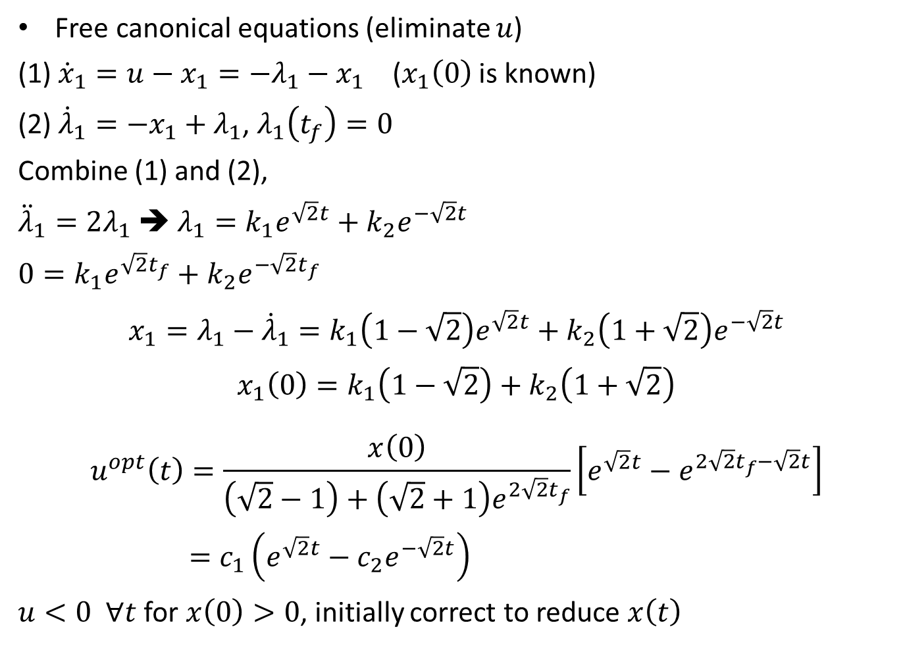
Free canonical equations (eliminate $u$)
(1) ${\dot{x}}_{1}=u−x_{1}=−λ_{1}−x_{1}$ ($x_{1}\left(0\right)$ is known)
(2) ${\dot{λ}}_{1}=−x_{1}+λ_{1}$, $λ_{1}\left(t_{f}\right)=0$
Combine (1) and (2),
${\ddot{λ}}_{1}=2λ_{1}$➔ $λ_{1}=k_{1}e^{\sqrt{2}t}+k_{2}e^{−\sqrt{2}t}$
$$0=k_{1}e^{\sqrt{2}t_{f}}+k_{2}e^{−\sqrt{2}t_{f}}$$
$$x_{1}=λ_{1}−{\dot{λ}}_{1}=k_{1}\left(1−\sqrt{2}\right)e^{\sqrt{2}t}+k_{2}\left(1+\sqrt{2}\right)e^{−\sqrt{2}t}$$
$$x_{1}\left(0\right)=k_{1}\left(1−\sqrt{2}\right)+k_{2}\left(1+\sqrt{2}\right)$$
$$u^{opt}\left(t\right)=\frac{x\left(0\right)}{\left(\sqrt{2}−1\right)+\left(\sqrt{2}+1\right)e^{2\sqrt{2}t_{f}}}\left[e^{\sqrt{2}t}−e^{2\sqrt{2}t_{f}−\sqrt{2}t}\right]=c_{1}\left(e^{\sqrt{2}t}−c_{2}e^{−\sqrt{2}t}\right)$$
$u<0 ∀t$ for $x\left(0\right)>0$, initially correct to reduce $x\left(t\right)$

Slide 13

Another example:
$${\dot{x}}_{1}=x_{2}$$
${\dot{x}}_{2}=u$ (double integrator)
$$V=\frac{1}{2}\int_{0}^{∞}{\left(x_{1}^{2}+x_{2}^{2}+u^{2}\right)dt}$$
$$H=\frac{1}{2}x_{1}^{2}+\frac{1}{2}x_{2}^{2}+\frac{1}{2}u^{2}+λ_{1}x_{2}+λ_{2}u$$
$${\dot{λ}}_{1}=−\frac{∂H}{∂x_{1}}=−x_{1}$$
$${\dot{λ}}_{2}=−\frac{∂H}{∂x_{2}}=−x_{2}−λ_{1}$$
$H_{u}=0=u+λ_{2}$ ➔ $u^{opt}=−λ_{2}$

Slide 14
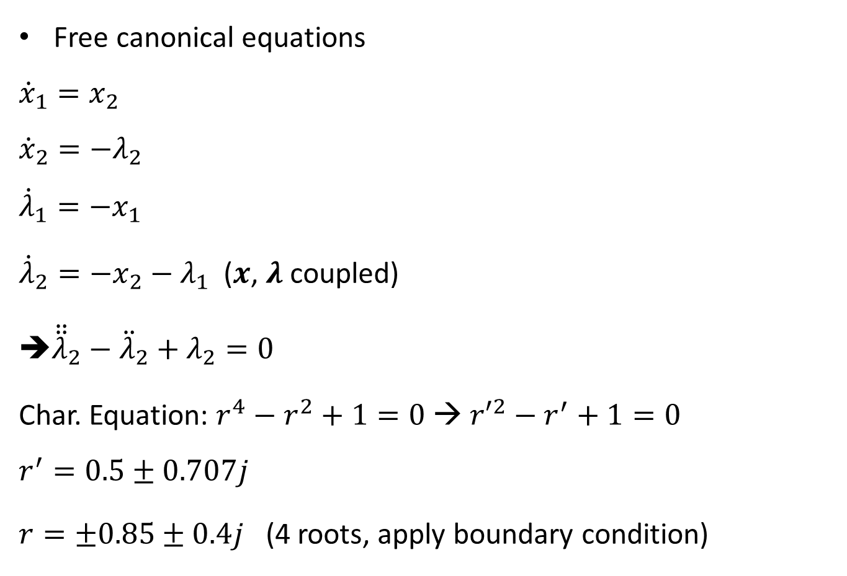
Free canonical equations
$${\dot{x}}_{1}=x_{2}$$
$${\dot{x}}_{2}=−λ_{2}$$
$${\dot{λ}}_{1}=−x_{1}$$
${\dot{λ}}_{2}=−x_{2}−λ_{1}$ ($x$, $λ$ coupled)
➔${\ddot{\ddot{λ}}}_{2}−{\ddot{λ}}_{2}+λ_{2}=0$
Char. Equation: $r^{4}−r^{2}+1=0$ → ${r′}^{2}−r^{′}+1=0$
$$r^{′}=0.5±0.707j$$
$r=±0.85±0.4j$ (4 roots, apply boundary condition)

Slide 15
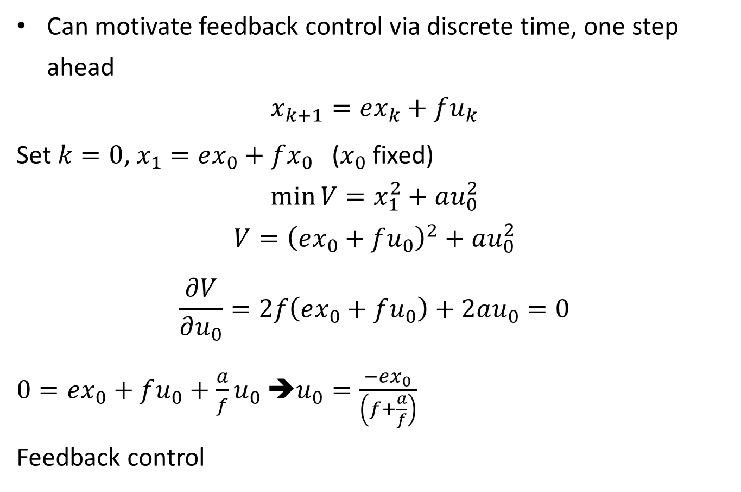
Can motivate feedback control via discrete time, one step ahead
$$x_{k+1}=ex_{k}+fu_{k}$$
Set $k=0$, $x_{1}=ex_{0}+fx_{0}$ ($x_{0}$ fixed)
$$\min{V=x_{1}^{2}+au_{0}^{2}}$$
$$V={\left(ex_{0}+fu_{0}\right)}^{2}+au_{0}^{2}$$
$$\frac{∂V}{∂u_{0}}=2f\left(ex_{0}+fu_{0}\right)+2au_{0}=0$$
$0=ex_{0}+fu_{0}+\frac{a}{f}u_{0}$ ➔$u_{0}=\frac{−ex_{0}}{\left(f+\frac{a}{f}\right)}$
Feedback control

Slide 16
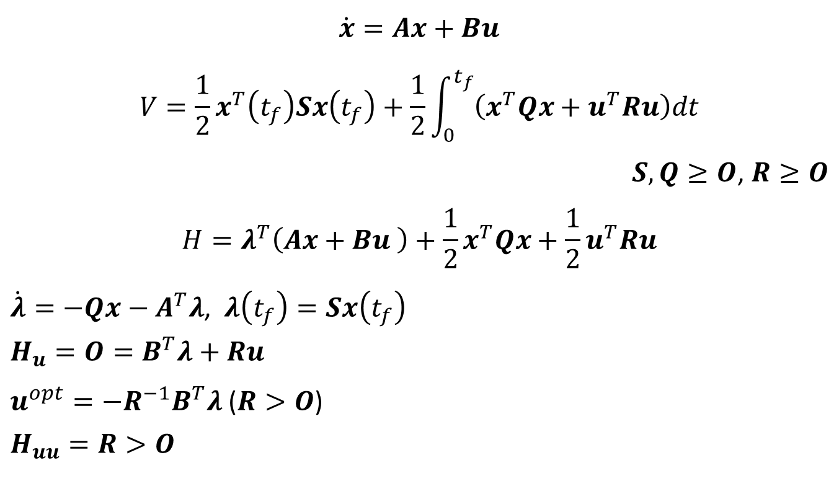
Continuous Time LQP
$$\dot{x}=Ax+Bu$$
$$V=\frac{1}{2}x^{T}\left(t_{f}\right)Sx\left(t_{f}\right)+\frac{1}{2}\int_{0}^{t_{f}}{\left(x^{T}Qx+u^{T}Ru\right)dt}$$
$S, Q≥O$, $R≥O$
$$H=λ^{T}\left(Ax+Bu \right)+\frac{1}{2}x^{T}Qx+\frac{1}{2}u^{T}Ru$$
$\dot{λ}=−Qx−A^{T}λ$, $λ\left(t_{f}\right)=Sx\left(t_{f}\right)$
$$H_{u}=O=B^{T}λ+Ru$$
$u^{opt}=−R^{−1}B^{T}λ$ ($R>O$)
$$H_{uu}=R>O$$

Slide 17
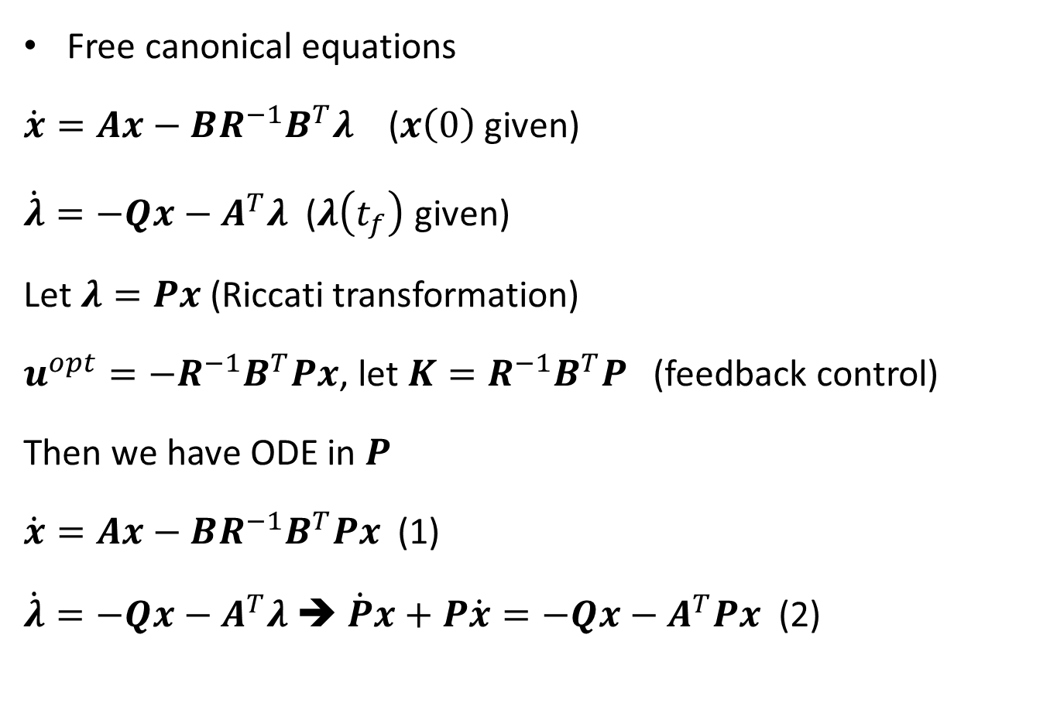
Free canonical equations
$\dot{x}=Ax−BR^{−1}B^{T}λ$ ($x\left(0\right)$ given)
$\dot{λ}=−Qx−A^{T}λ$ ($λ\left(t_{f}\right)$ given)
Let $λ=Px$ (Riccati transformation)
$u^{opt}=−R^{−1}B^{T}Px$, let $K=R^{−1}B^{T}P$ (feedback control)
Then we have ODE in $P$
$\dot{x}=Ax−BR^{−1}B^{T}Px$ (1)
$\dot{λ}=−Qx−A^{T}λ$ ➔ $\dot{P}x+P\dot{x}=−Qx−A^{T}Px$ (2)

Slide 18
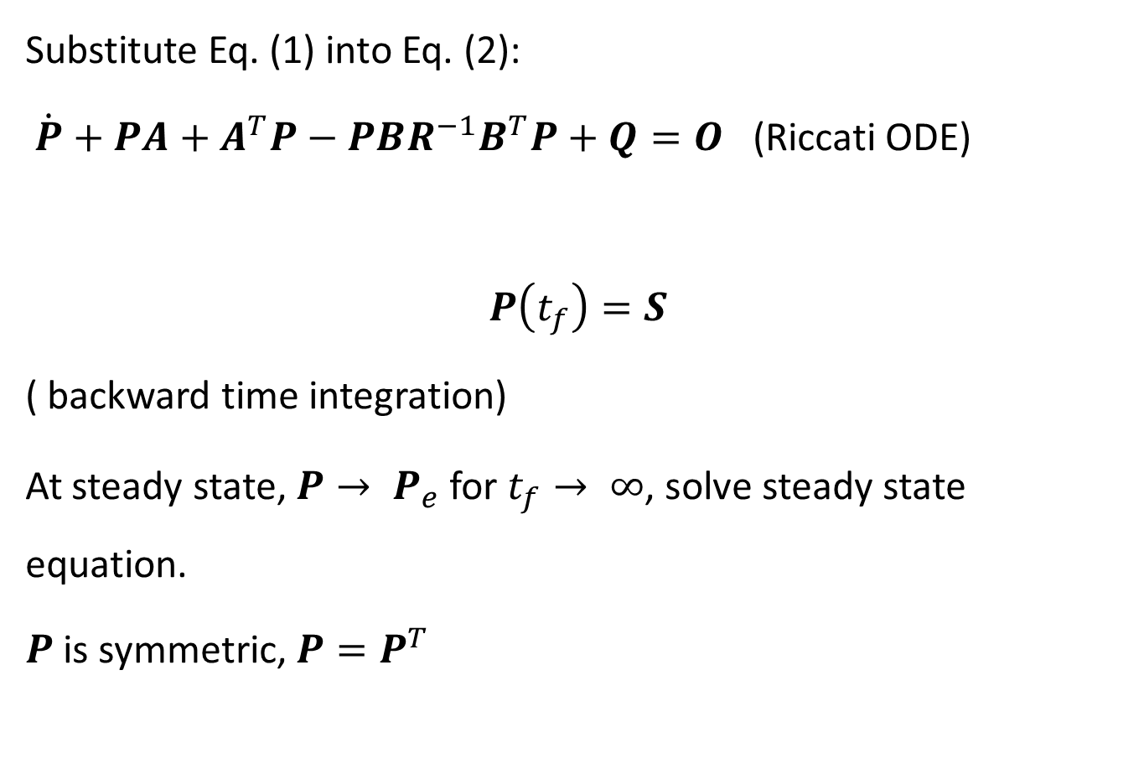
Substitute Eq. (1) into Eq. (2):
$\dot{P}+PA+A^{T}P−PBR^{−1}B^{T}P+Q=O$ (Riccati ODE)
$$P\left(t_{f}\right)=S$$
( backward time integration)
At steady state, $P→ P_{e}$ for $t_{f}→ ∞$, solve steady state equation.
$P$ is symmetric, $P=P^{T}$

Slide 19
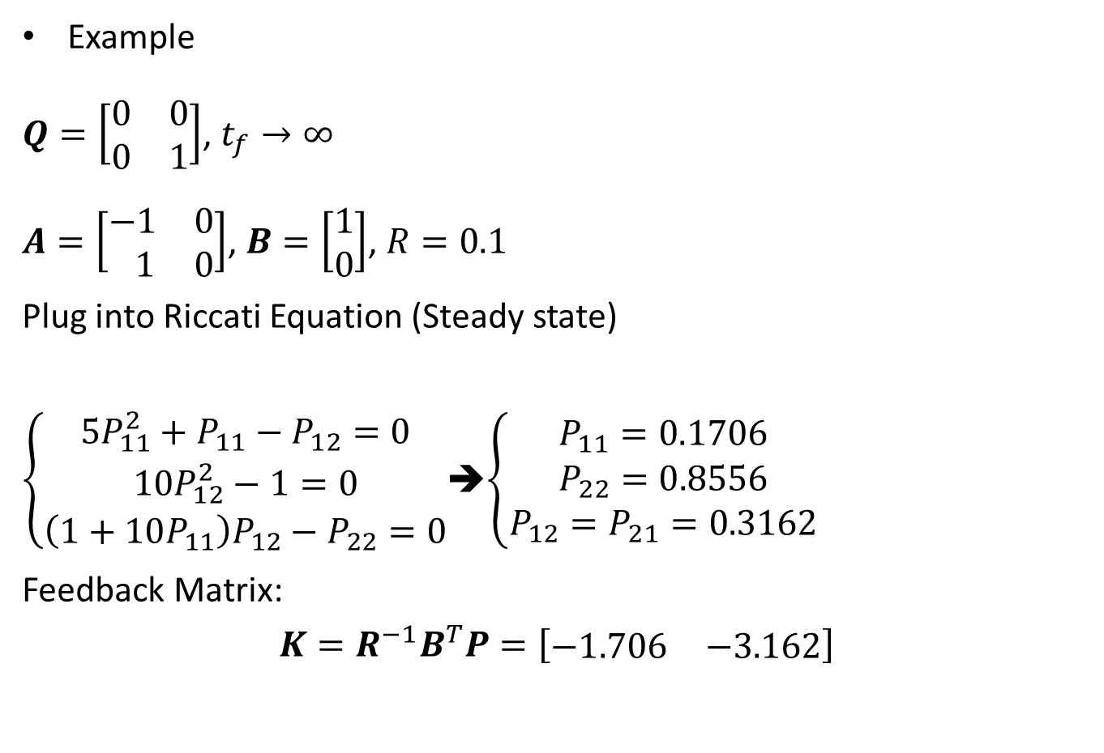
Example
$Q=\left[\begin{matrix}0 & 0 \\ 0 & 1\end{matrix}\right]$, $t_{f}→∞$
$A=\left[\begin{matrix}−1 & 0 \\ 1 & 0\end{matrix}\right]$, $B=\left[\begin{matrix}1 \\ 0\end{matrix}\right]$, $R=0.1$
Plug into Riccati Equation (Steady state)
$\left\{\begin{aligned}5P_{11}^{2}+P_{11}−P_{12}=0 \\ 10P_{12}^{2}−1=0 \\ \left(1+10P_{11}\right)P_{12}−P_{22}=0\end{aligned}\right.$➔$\left\{\begin{aligned}P_{11}=0.1706 \\ P_{22}=0.8556 \\ P_{12}=P_{21}=0.3162\end{aligned}\right.$
Feedback Matrix:
$$K=R^{−1}B^{T}P=\left[\begin{matrix}−1.706 & −3.162\end{matrix}\right]$$

Slide 20
Generally 3 ways to solve steady state Riccati Equation:
(1) integration of ode’s → steady state;
(2) Newton-Raphson (non linear equation solver);
(3) transition matrix (analytical solution).

Slide 21
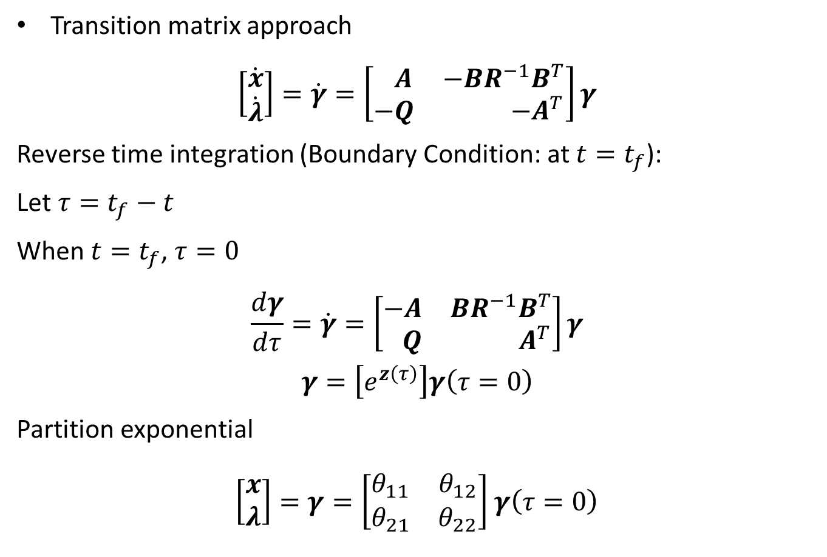
Transition matrix approach
$$\left[\begin{matrix}\dot{x} \\ \dot{λ}\end{matrix}\right]=\dot{γ}=\left[\begin{matrix} A & −BR^{−1}B^{T} \\ −Q & −A^{T}\end{matrix}\right]γ$$
Reverse time integration (Boundary Condition: at $t=t_{f}$):
Let $τ=t_{f}−t$
When $t=t_{f}$, $τ=0$
$$\frac{dγ}{dτ}=\dot{γ}=\left[\begin{matrix}−A & BR^{−1}B^{T} \\ Q & A^{T}\end{matrix}\right]γ$$
$$γ=\left[e^{z\left(τ\right)}\right]γ\left(τ=0\right)$$
Partition exponential
$\left[\begin{matrix}x \\ λ\end{matrix}\right]=γ=\left[\begin{matrix}θ_{11} & θ_{12} \\ θ_{21} & θ_{22}\end{matrix}\right]$ $γ\left(τ=0\right)$

Slide 22
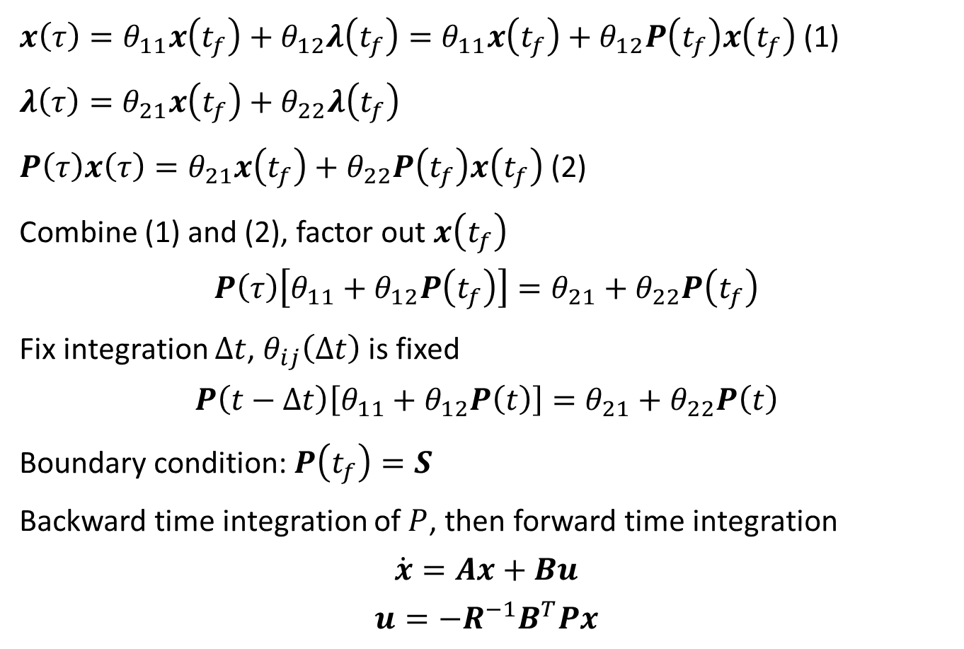
$x\left(τ\right)=θ_{11}x\left(t_{f}\right)+θ_{12}λ\left(t_{f}\right)=θ_{11}x\left(t_{f}\right)+θ_{12}P\left(t_{f}\right)x\left(t_{f}\right)$ (1)
$λ\left(τ\right)=θ_{21}x\left(t_{f}\right)+θ_{22}λ\left(t_{f}\right)$
$P\left(τ\right)x\left(τ\right)=θ_{21}x\left(t_{f}\right)+θ_{22}P\left(t_{f}\right)x\left(t_{f}\right)$ (2)
Combine (1) and (2), factor out $x\left(t_{f}\right)$
$$P\left(τ\right)\left[θ_{11}+θ_{12}P\left(t_{f}\right)\right]=θ_{21}+θ_{22}P\left(t_{f}\right)$$
Fix integration $∆t$, $θ_{ij}\left(Δt\right)$ is fixed
$$P\left(t−∆t\right)\left[θ_{11}+θ_{12}P\left(t\right)\right]=θ_{21}+θ_{22}P\left(t\right)$$
Boundary condition: $P\left(t_{f}\right)=S$
Backward time integration of $P$, then forward time integration
$$\dot{x}=Ax+Bu$$
$$u=−R^{−1}B^{T}Px$$

Slide 23
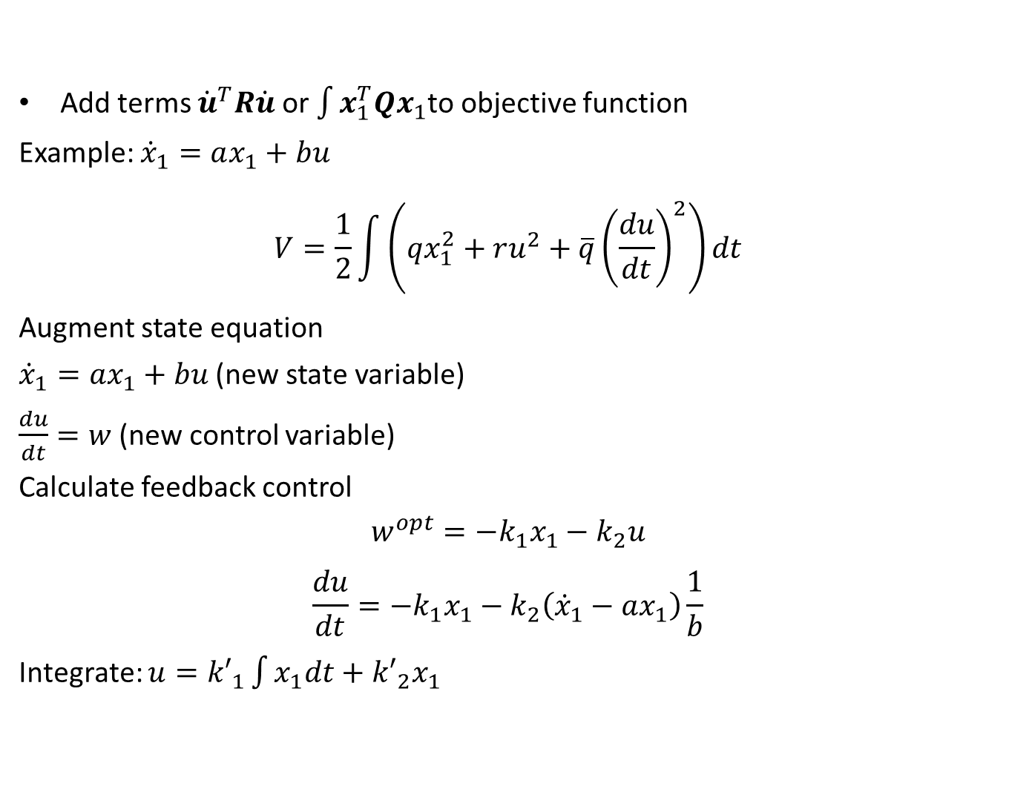
Integral Action (eliminate offset)
Add terms ${\dot{u}}^{T}R\dot{u}$ or $\int{x_{1}^{T}Qx_{1}}$to objective function
Example: ${\dot{x}}_{1}=ax_{1}+bu$
$$V=\frac{1}{2}\int{\left(qx_{1}^{2}+ru^{2}+\overline{q}{\left(\frac{du}{dt}\right)}^{2}\right)dt}$$
Augment state equation
${\dot{x}}_{1}=ax_{1}+bu$ (new state variable)
$\frac{du}{dt}=w$ (new control variable)
Calculate feedback control
$$w^{opt}=−k_{1}x_{1}−k_{2}u$$
$$\frac{du}{dt}=−k_{1}x_{1}−k_{2}\left({\dot{x}}_{1}−ax_{1}\right)\frac{1}{b}$$
Integrate: $u={k′}_{1}\int{x_{1}dt}+{k′}_{2}x_{1}$

Slide 24

Second method:
$x_{0}=\int{x_{1}dt}$; ${\dot{x}}_{0}=x_{1}$
$$V=\frac{1}{2}\int{\left(qx_{1}^{2}+ru^{2}+\overline{q}{\left(x_{0}\right)}^{2}\right)dt}$$
$${\dot{x}}_{0}=x_{1}$$
$${\dot{x}}_{1}=ax_{1}+bu$$
Optimal control:
$$u=−k_{1}x_{1}−k_{0}x_{0}=−k_{1}x_{1}−k_{0}\int{x_{1}dt}$$
With more state variables, ➔ PID controller

